Slide 1
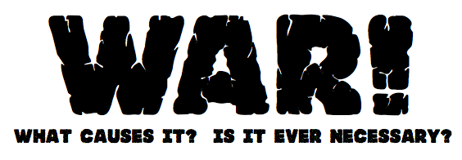

Slide 2
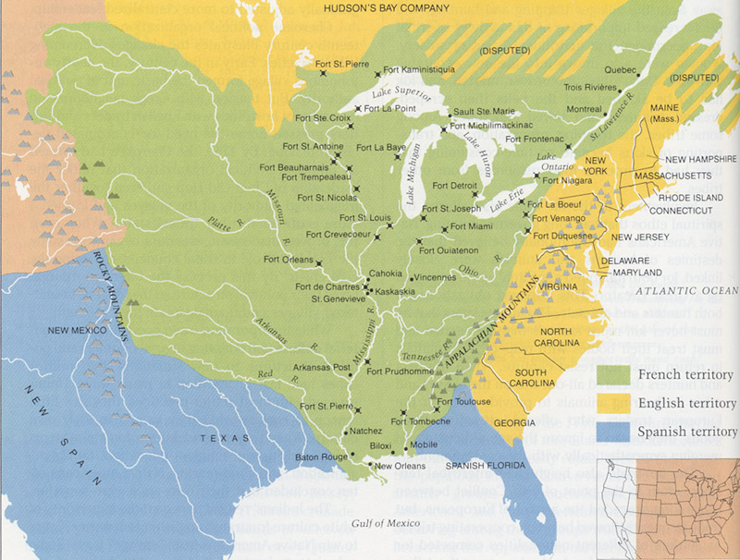

Slide 3
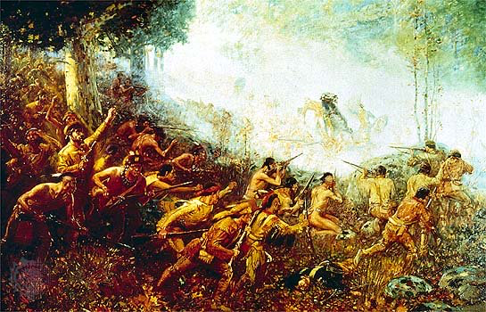
The French and Indian War was fought between the Colonists & the British VS. The French & Native Americans

Slide 4
The French and Indian War was caused by:
1.)
Land:
Both France and Britain wanted control of the valuable Ohio River Valley.
2.)
People:
British colonists moved into region, which disrupted trade between Natives & French.
3.)
Conflict:
The war in the Americas is just one of several wars between France & Britain.

Slide 5
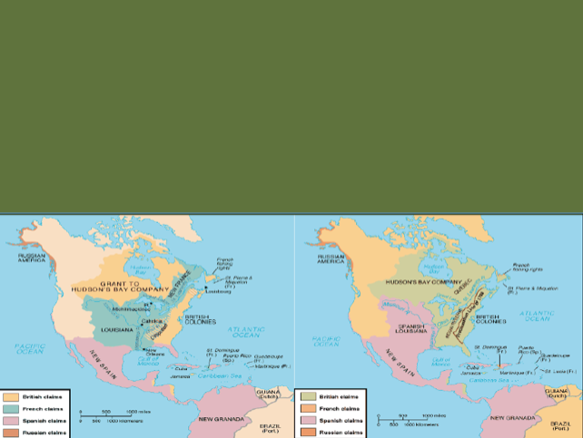
Effect #1:
The Treaty of Paris (1763)
Ends the War
France relinquishes all land in North America
Everything east of Mississippi River now belongs to Britain
Natives lose their ally and trading partner

Slide 6
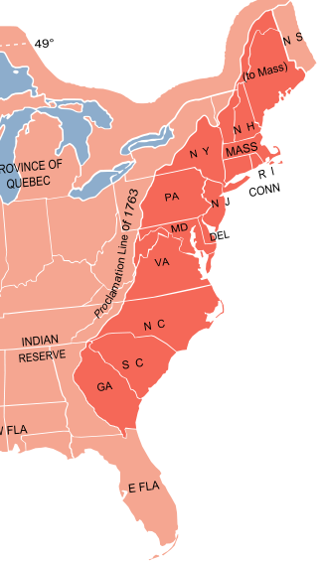
Effect #2:
The Proclamation of 1763
Colonists are not allowed to move west of the Appalachian Mountains.
Britain fears sparking another war with the natives (a big no-no after just spending a lot of resources to fight a war).
Colonists are furious they cannot move west into the land they just fought for.

Slide 7
Effect #3:
DEBT
Great Britain is saddled with a huge war debt from fighting the F&I War (paying for weapons and soldiers is expensive!)
British Parliament begins taxing colonies to repay the debt incurred.

Slide 8
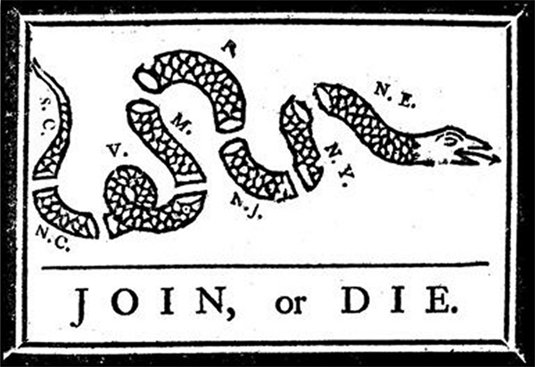
Effect #4:
COLONISTS UNITE !
- At outset of F&I War, Ben Franklin leads Albany Congress to unite colonists to “Join, or Die” against the French
Colonists learn guerrilla warfare tactics used by natives and French
Colonists learn to fight as one!

